Slide 1

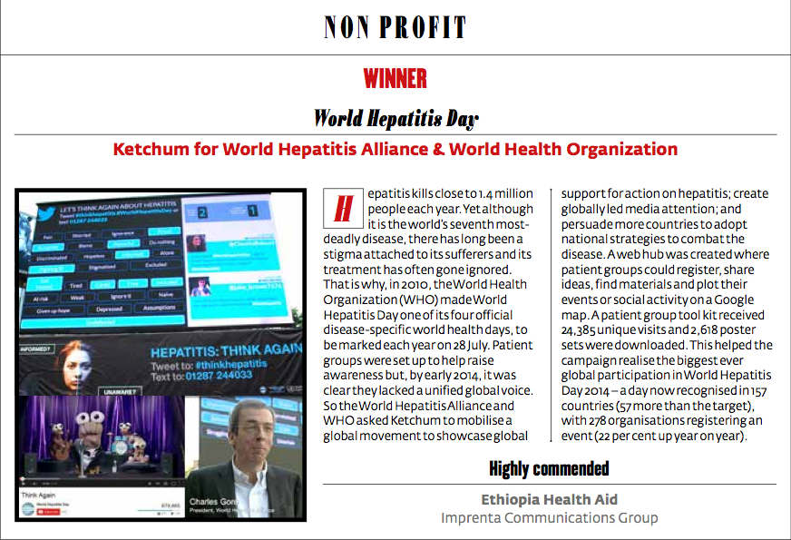
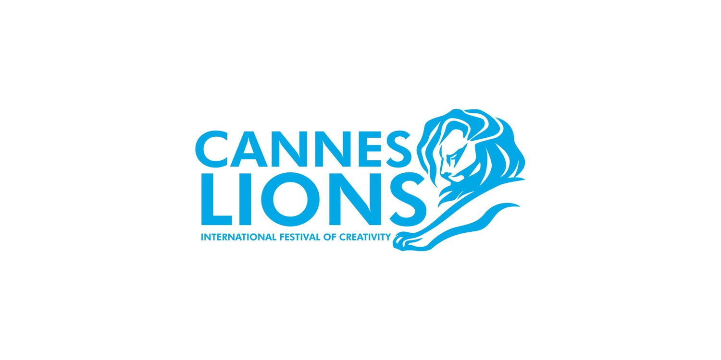

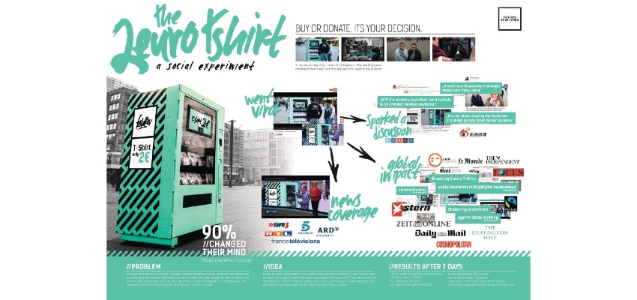
2015 Awards Roundup
Highlights!
Wins, finalists + significant award milestones!
Notes:
PR WEEK GLOBAL AWARDS
In the Non-Profit category, Ketchum for World Hepatitis Alliance and World Health Organization, won with the World Hepatitis Day campaign.
Link(s): http://static.webvid.co.uk/assets/1430390924%20PRWGlobalAwards2015FINAL.pdf
http://www.globalprweekawards.com/global-awards/results/
EUROBEST
2 Euro T-shirt (Fashion Revolution) campaign which won Silver in PR at Eurobest. The campaign also won Bronze in both Media, and Promo & Activation (the latter two entries led by BBDO Group Germany). Three wins are very impressive. Note: Chief Engagement Officer Stephen Waddington, was amongst the panel of judges for Eurobest!
Silver
PR - Events & Experimental: Fashion Revolution, The 2-Euro T-shirt (Ketchum Pleon & BBDO)
Bronze
Media - Charities, Public Health, Safety & Awareness Messages: Fashion Revolution, The 2-Euro T-shirt (BBDO & Ketchum Pleon)
Promotion & Activation - Use Of Promotional Events & Stunts: Fashion Revolution, The 2-Euro T-shirt (BBDO and Ketchum Pleon)
CANNES LIONS
2015 Cannes Lions International Festival of Creativity, in total Ketchum had 17 awards shortlisted and the teams took home one Silver and two Bronze. Continuing on the awards path, Wendy's Pretzel Bacon Cheeseburger won the Silver Lion for Original Use of Music and another Bronze in the Radio category, while we also won a Bronze PR Lion in the Charity and Not-For-Profit category for "The 2-Euro T-Shirt: A Social Experiment" Fashion Revolution, with Ketchum Pleon and BBDO Group Germany.
Link: http://www.marketwatch.com/story/ketchum-fashion-revolution-and-bbdo-group-germany-win-bronze-pr-lion-at-cannes-lions-international-festival-of-creativity-2015-06-24/print

Slide 2
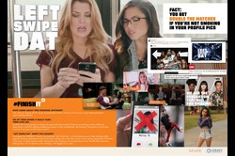


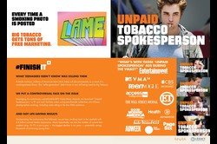
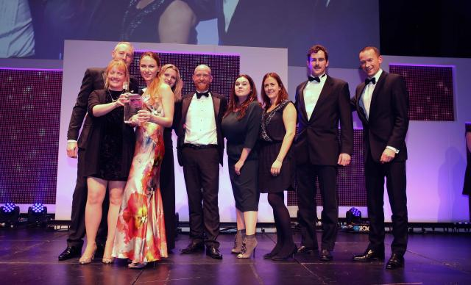
2015 Awards Roundup
Highlights – cont.
Wins, finalists + significant award milestones!
Notes:
CLIO HEALTHCARE AWARDS
Ketchum New York and the Truth Initiative won two Gold awards in the Public Relations category at the CLIO Healthcare Awards held in New York, proclaimed as one of the world’s leading and most competitive award shows rewarding breakthrough creativity:
Lifestyle: Truth Initiative, Left Swipe Dat (Ketchum)
Health Services & Corporate Communications: Truth Initiative, Unpaid Spokesperson (Ketchum)
Additionally: 2 Euro T-shirt (Fashion Revolution) from Ketchum Pleon Germany was a finalist and recognized with a mention on the shortlist of the main CLIO Awards, which is in itself a major honor at this highly competitive show.
Link(s): http://www.cliohealthcare.com/winners/2015/all/entry.cfm?entryid=401510649&ispartofcampaign=0&index=14
http://www.cliohealthcare.com/winners/2015/all/entry.cfm?entryid=401510648&ispartofcampaign=0&index=13
CORPCOMMS MAGAZINE
UK magazine, CorpComms crowned Ketchum London, Agency of the Decade!
Link: http://www.corpcommsmagazine.co.uk/awards/corpcomms/decade-of-excellence

Slide 3
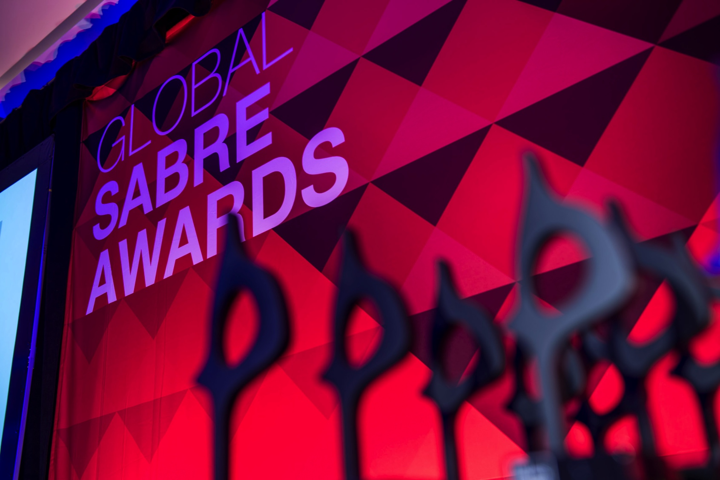
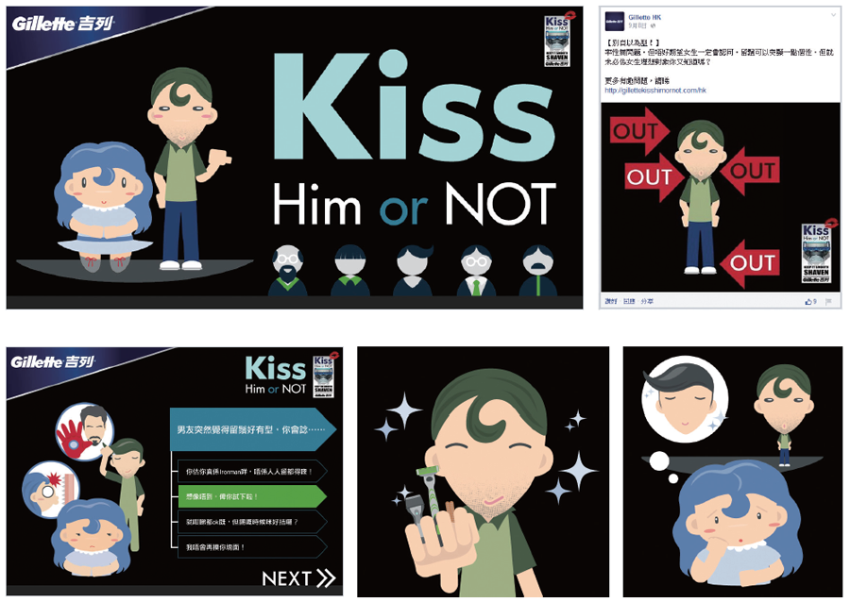
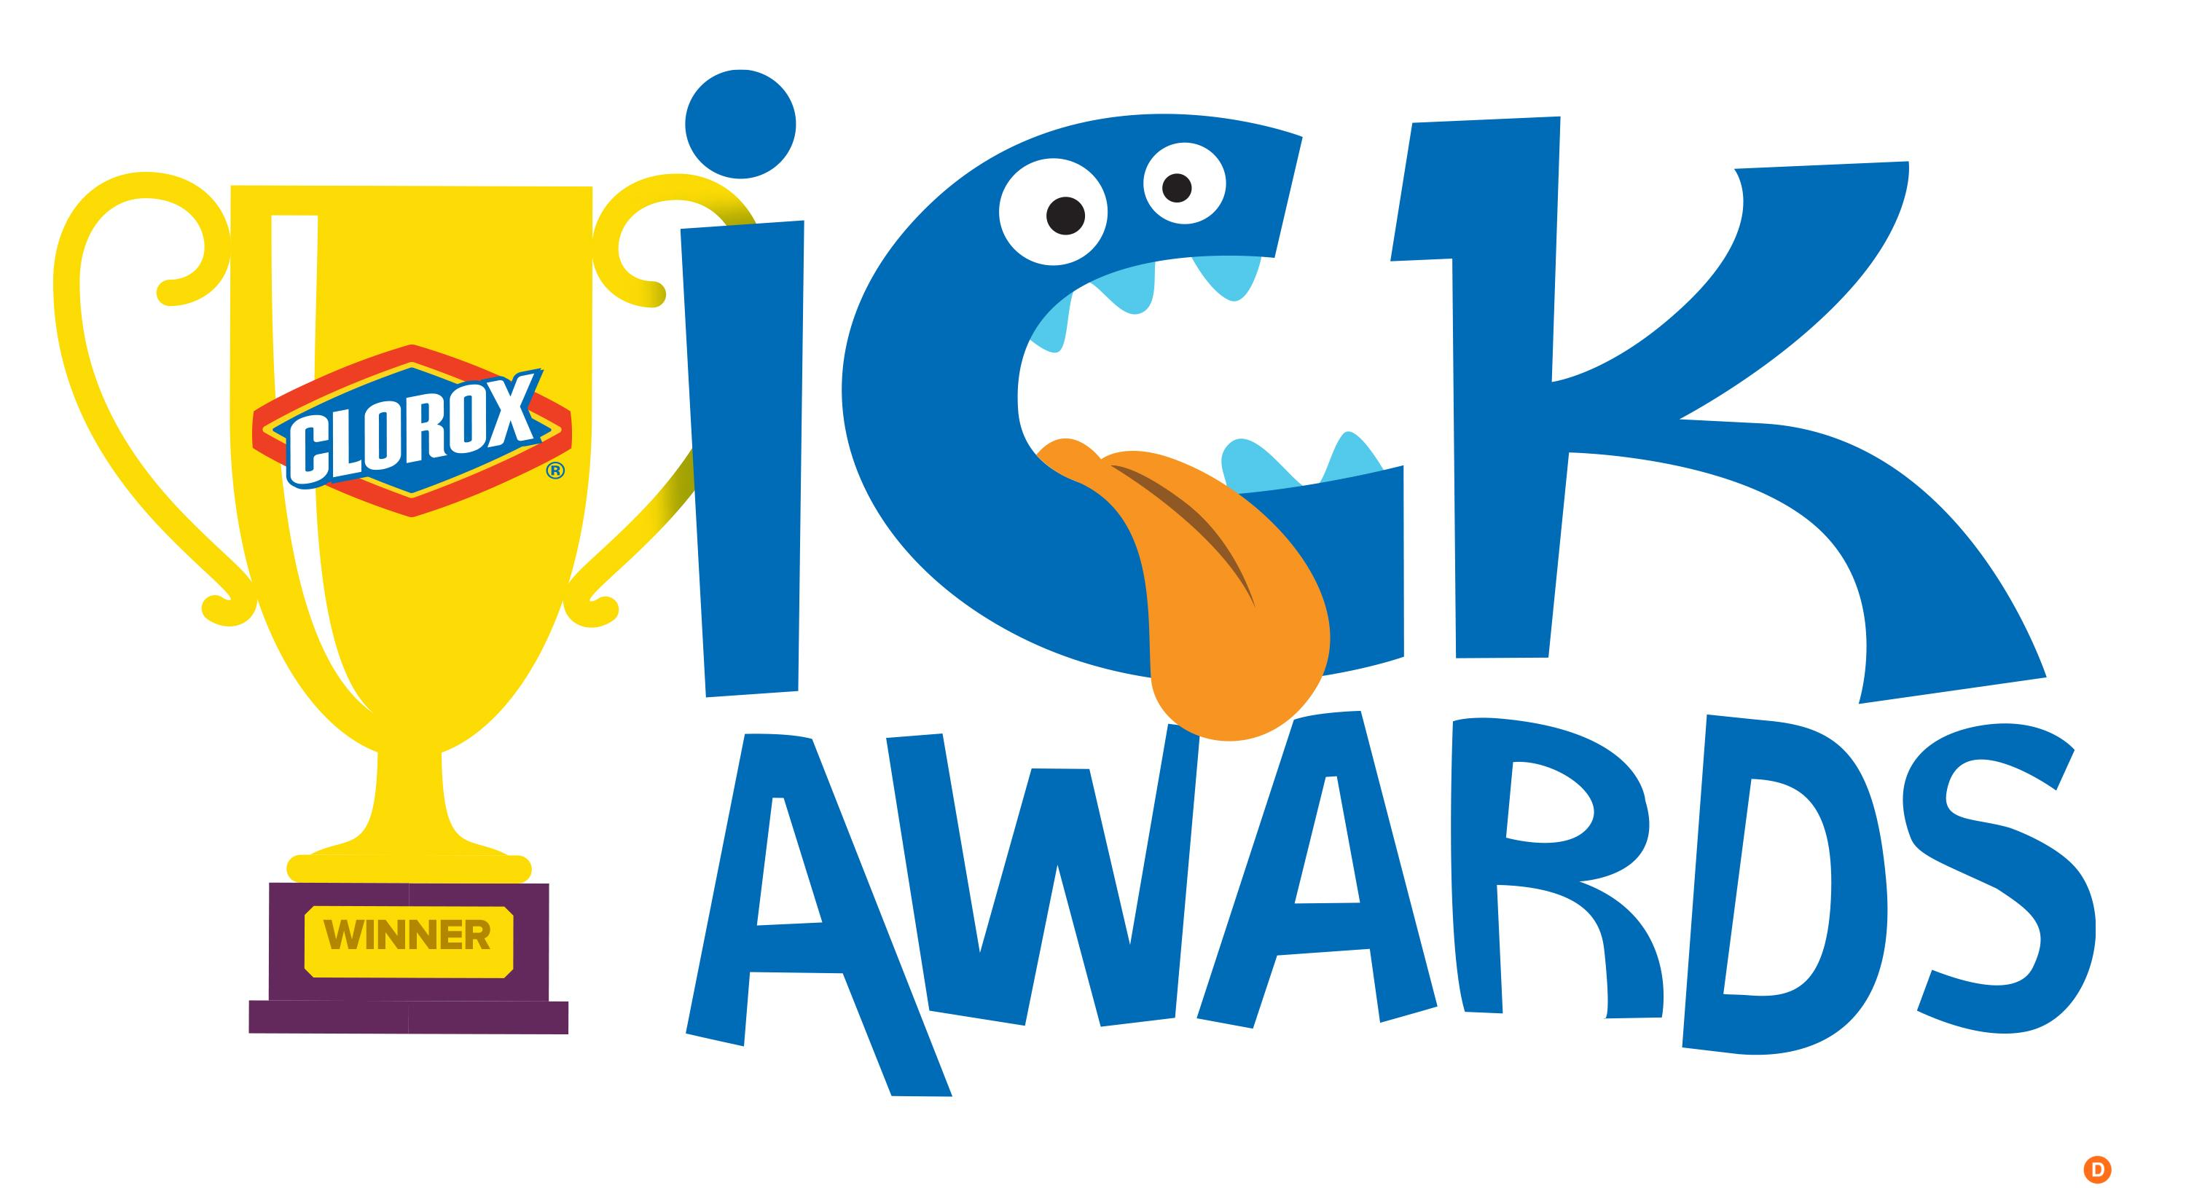
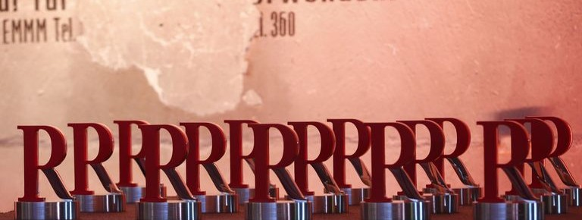

2015 Awards Roundup
Highlights – cont.
Wins, finalists + significant award milestones!
Notes:
GLOBAL SABRE AWARDS
Holmes Report selected the 40 best campaigns of the year from nearly 5,000 entries in regional SABRE Award competitions covering North America, EMEA, Asia-Pacific and Latin American – and Ketchum made the list four times! This year, for the first time, the winning campaigns were ranked – here are our winners:
(#10) The Clorox Company, The Clorox Ick Awards (Ketchum)
(#13) Mercedes-Benz Korea, Art & Heart (Ketchum Korea)
(#20) Bolton Austria, The Mystery Scent Oasis (Ketchum Publico)
(#35) Hilton Buenos Aires, It Happened At Hilton Buenos Aires, Barbie Room (Ketchum Argentina)
Link: http://www.holmesreport.com/events-awards/sabre-awards/global-sabre-awards/2015-global-sabre-awards
ASIA-PACIFIC SABRE Awards for HONG KONG
One of two SABREs and two certificates of excellence our Asia offices brought home for the region:
Multi-Country: Gillette, Kiss Him Or Not (Ketchum Hong Kong)
Best Use of Facebook – certificate of excellence
Best Use of Digital Video – certificate of excellence
Link: http://www.holmesreport.com/events-awards/sabre-awards/sabre-awards-asiapacific/finalists
SILVER ANVIL AWARDS – MOST FOR ANY AGENCY
In June 2015, at a Public Relations Society of America (PRSA) ceremony in New York, Ketchum won four Silver Anvil Awards and 12 Awards of Excellence. These latest wins bring Ketchum's all-time Silver Anvil tally to 163, and help us maintain our record as the agency with the most Silver Anvil wins since the program began!
Link: http://www.prsa.org/Awards/SilverAnvil/SilverAnvilResults/PreviousResults/2015SilverAnvilResults.pdf
GERMANY – MOST PR REPORT AWARDS EVER FOR AN AGENCY
Ketchum Pleon and Ketchum Publico together combined to win five PR Report Awards, the most of any agency:
Ketchum Publico - Die Borotalco Duftoase - Winner, Consumer Marketing
Ketchum Pleon - Novartis Vaccines, Anne Geddes Kids' Portraits for World Meningitis Day - Winner, Brand and Products, Healthcare
Ketchum Pleon - East German Universities, Whatsapp Study Information - Winner, Innovative Idea & Technology
Ketchum Pleon - Daimler, Mercedes Benz, We Are Ready as Never Before! - Winner, Essentials - Long Term Communications
Ketchum Pleon - Bosch, Der Sound Zum Spiel - Winner, PR Film
Press Release (in German): http://www.kpg-blog.de/punktlandung-ketchum-pleon-gewinnt-fuenf-pr-report-awards/

Slide 4
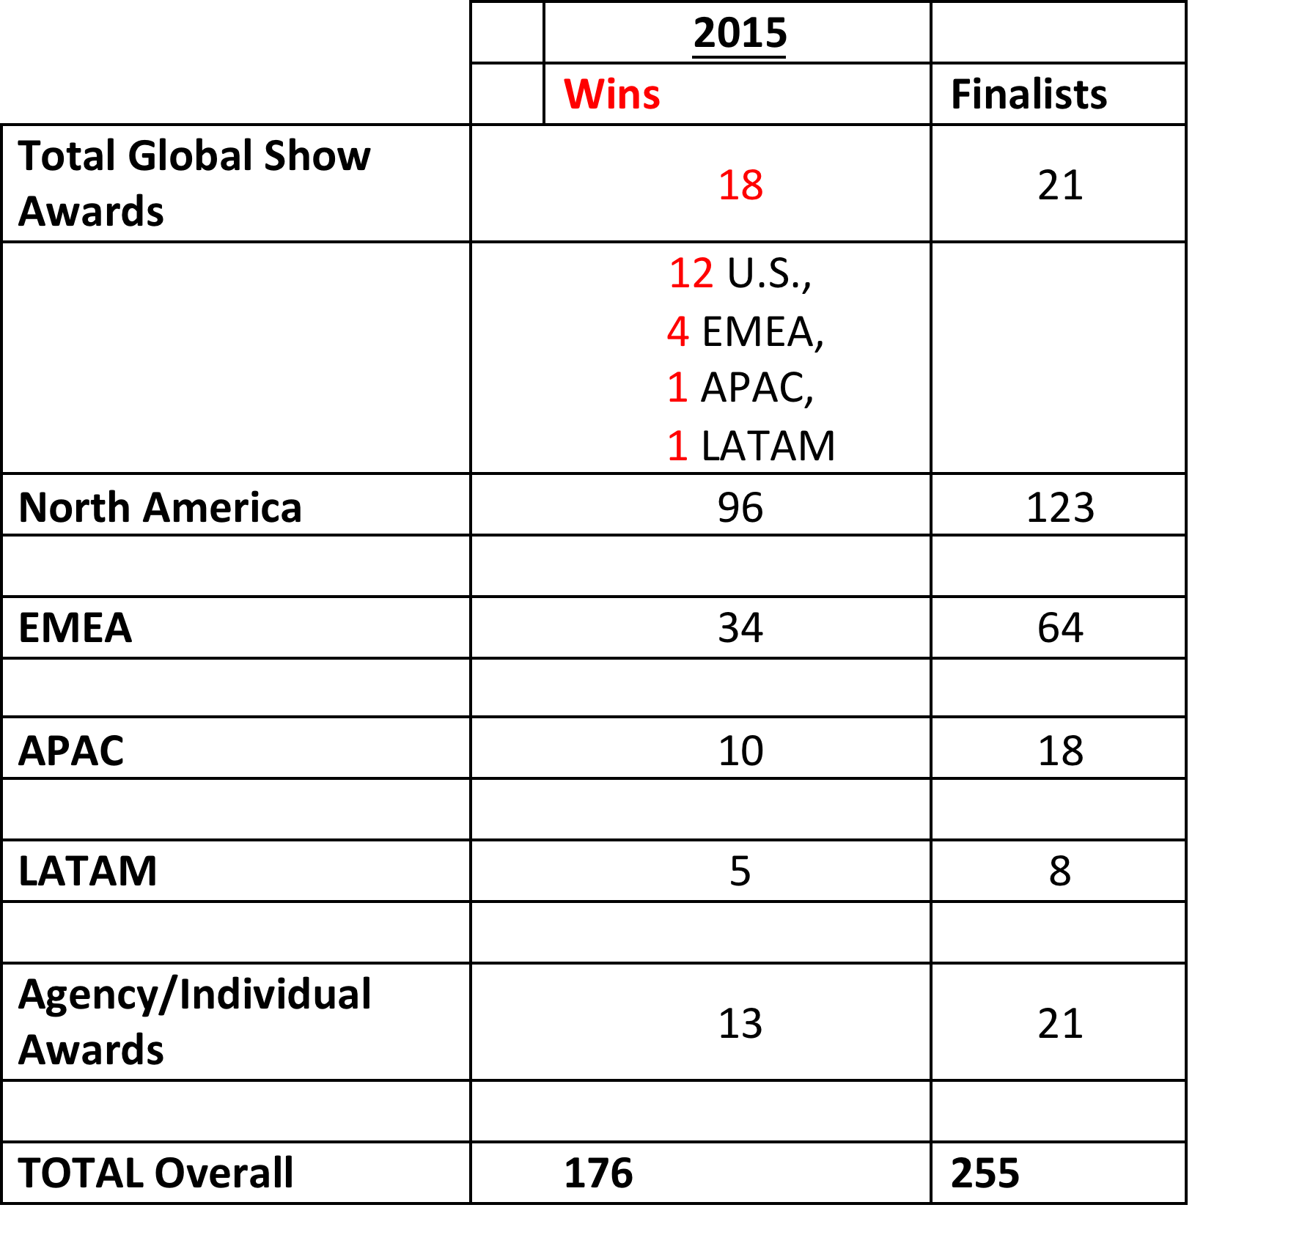
A Tally: # of wins & finalists figures!

